Slide 1
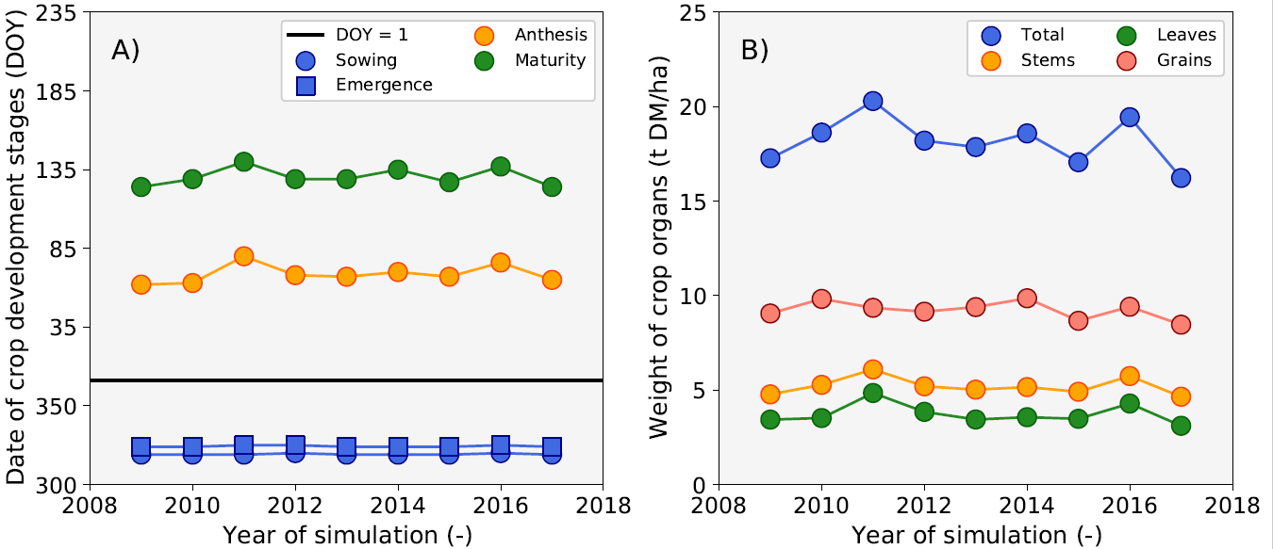
Nile delta Overview

Slide 2
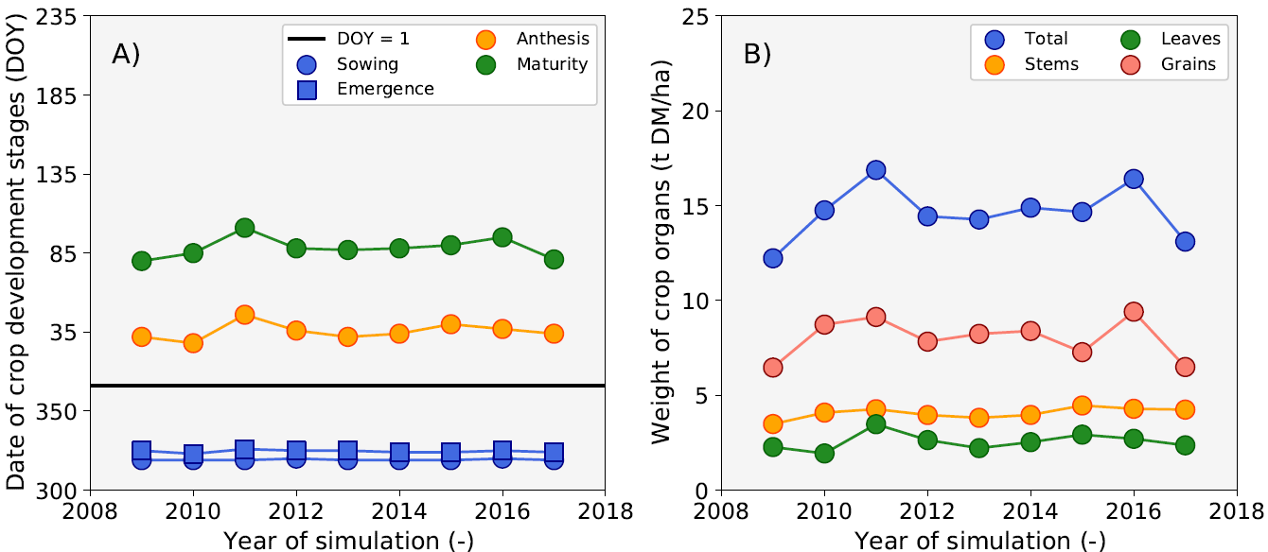
Upper Egypt Overview

Slide 3
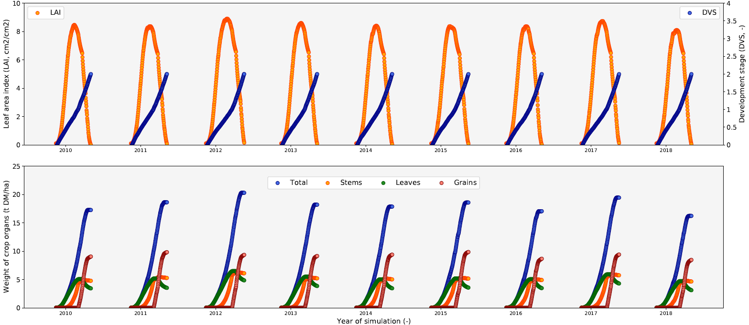
Nile delta Daily trends

Slide 4
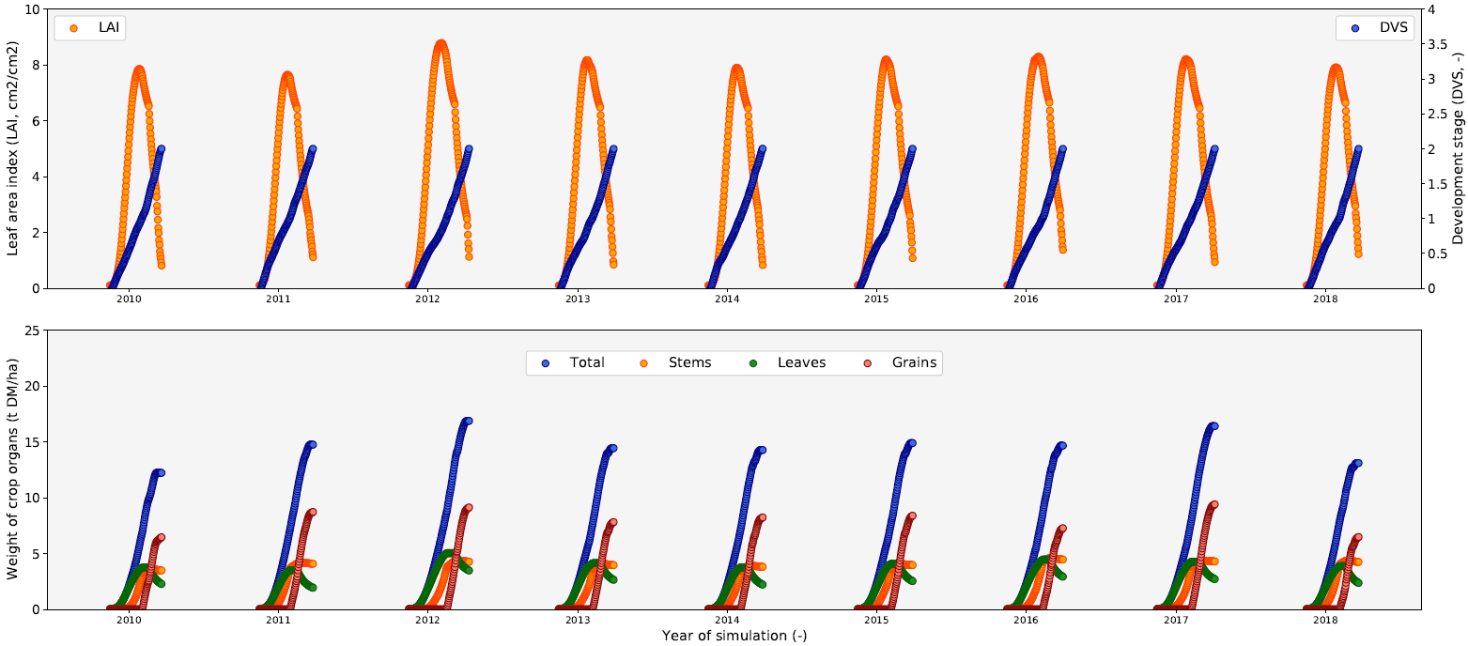
Upper Egypt Daily trends

Slide 5
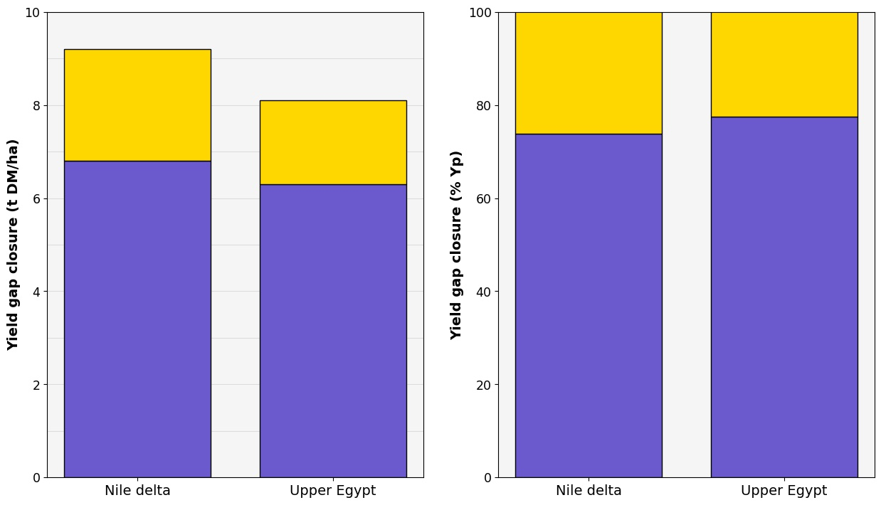
Yield gap closure

